Slide 1


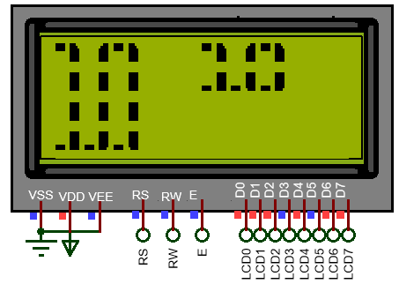
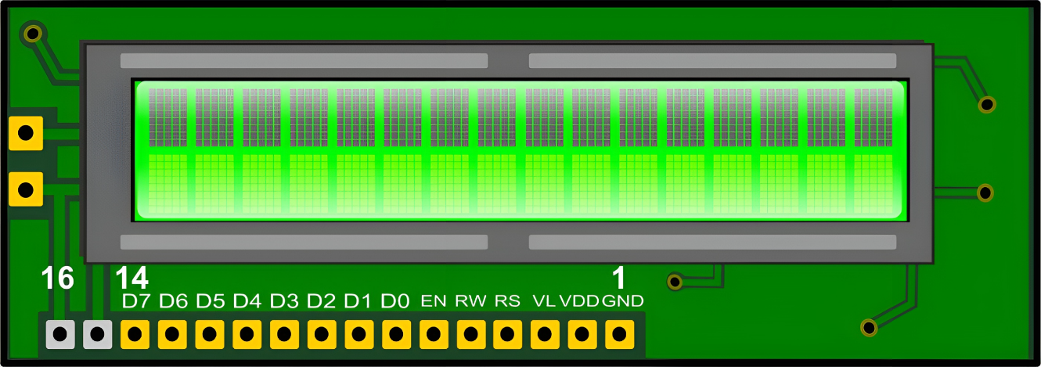
STM32 – ARM CORTEX M
LAB 4:
GPIO – LCD
STM32 EMBEDDED PROGRAMING
DO TRUNG HAU

Slide 2

CONTENTS
1. CONTROL LCD IN 8 BIT MODE
2. CONTROL LCD IN 4 BIT MODE
3. CONTROL LCD WITH I2C
4. CREATING CUSTOM CHARACTER
STM32 EMBEDDED SYSTEMS
ARM CORTEX M

Slide 3
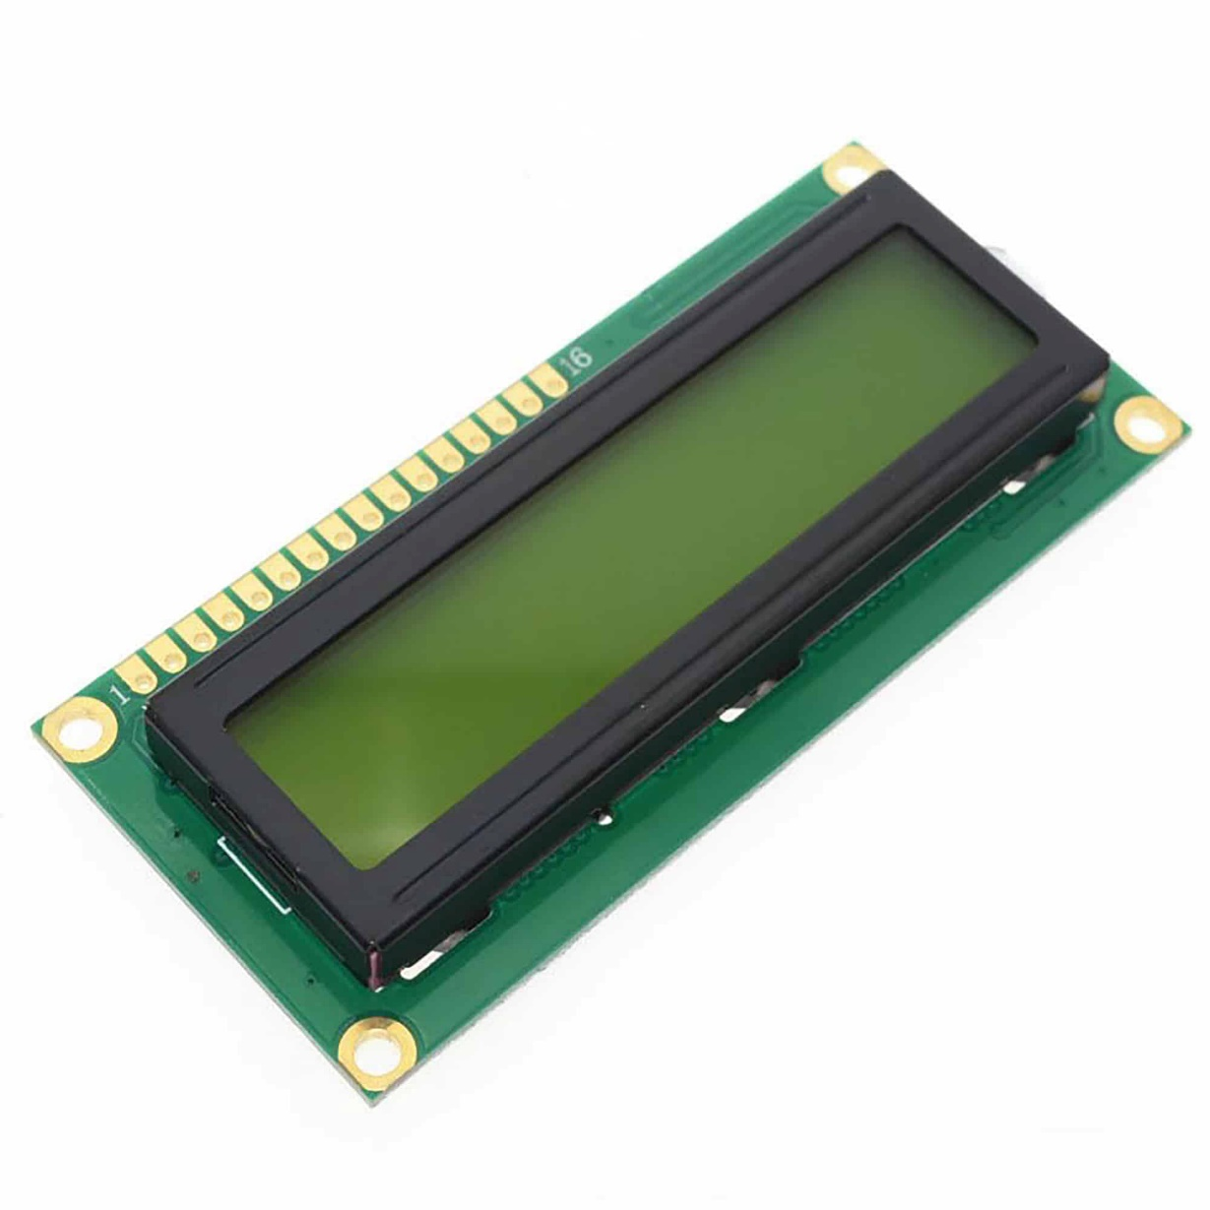
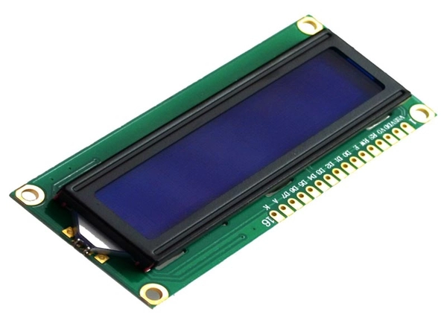
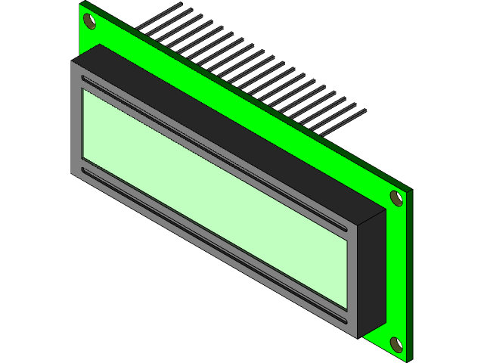
LAB 4: GPIO – LCD
1. CONTROL LCD IN 8 BIT MODE
LCD16X2 AND LCD20X4
STM32 EMBEDDED SYSTEMS
ARM CORTEX M

Slide 4
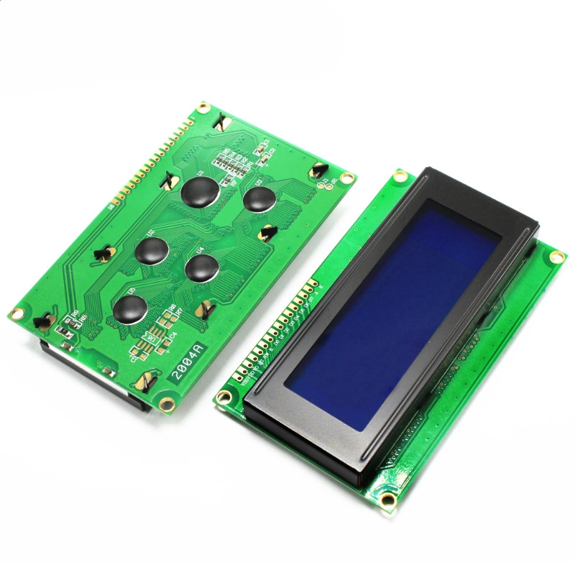
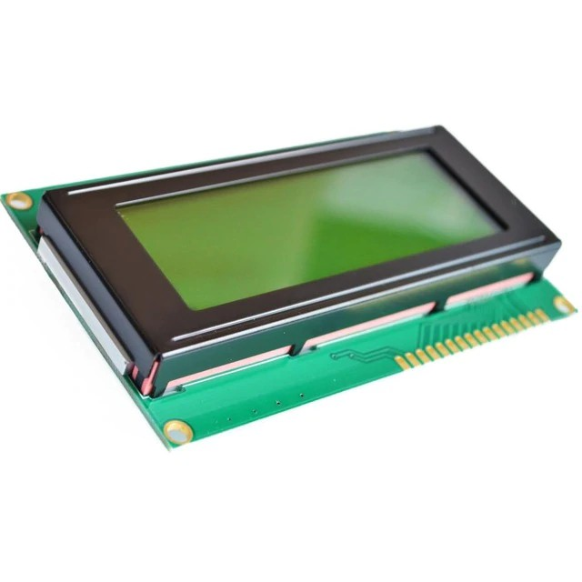
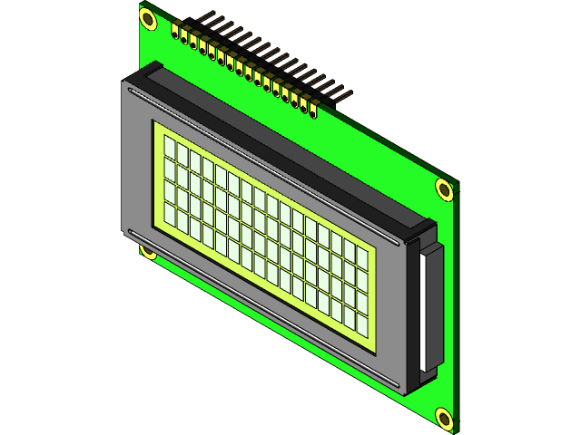
LAB 4: GPIO – LCD
1. CONTROL LCD IN 8 BIT MODE
LCD16X2 AND LCD20X4
STM32 EMBEDDED SYSTEMS
ARM CORTEX M

Slide 5
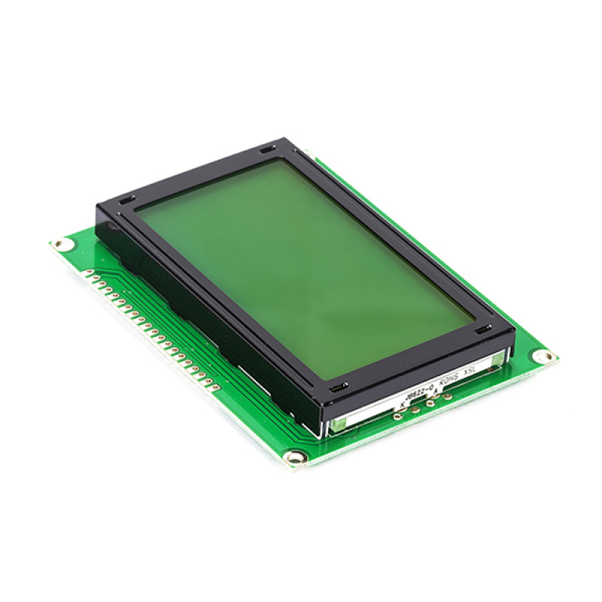
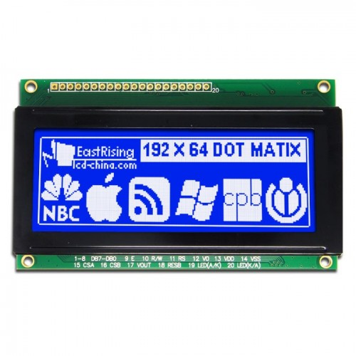
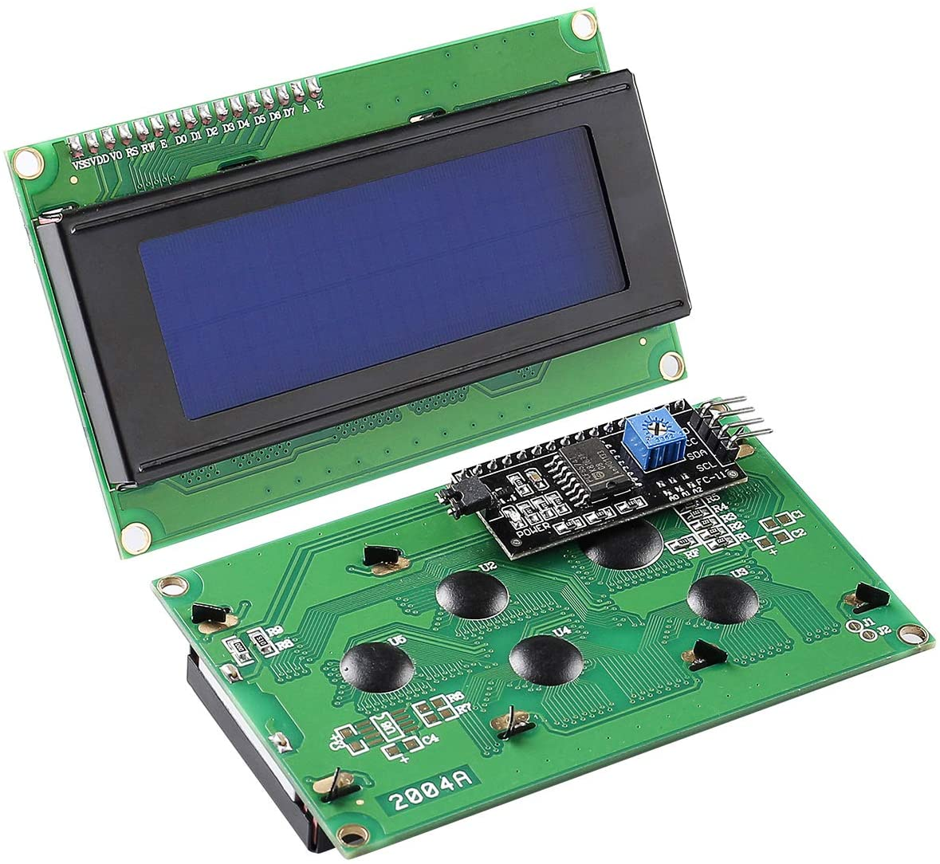
LAB 4: GPIO – LCD
1. CONTROL LCD IN 8 BIT MODE
LCD16X2 AND LCD20X4
STM32 EMBEDDED SYSTEMS
ARM CORTEX M

Slide 6
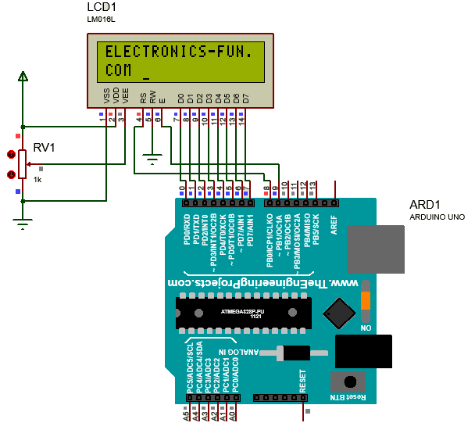
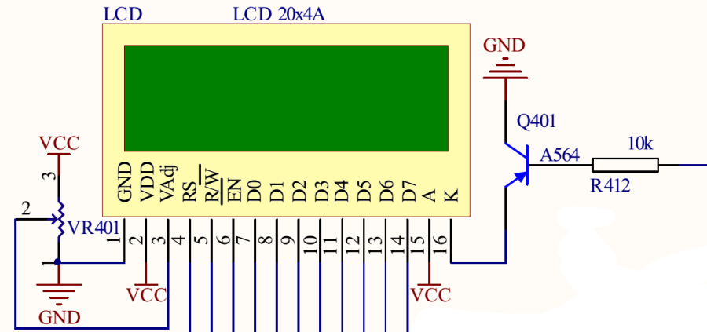
LAB 4: GPIO – LCD
1. CONTROL LCD IN 8 BIT MODE
LCD16X2 AND LCD20X4
STM32 EMBEDDED SYSTEMS
ARM CORTEX M

Slide 7
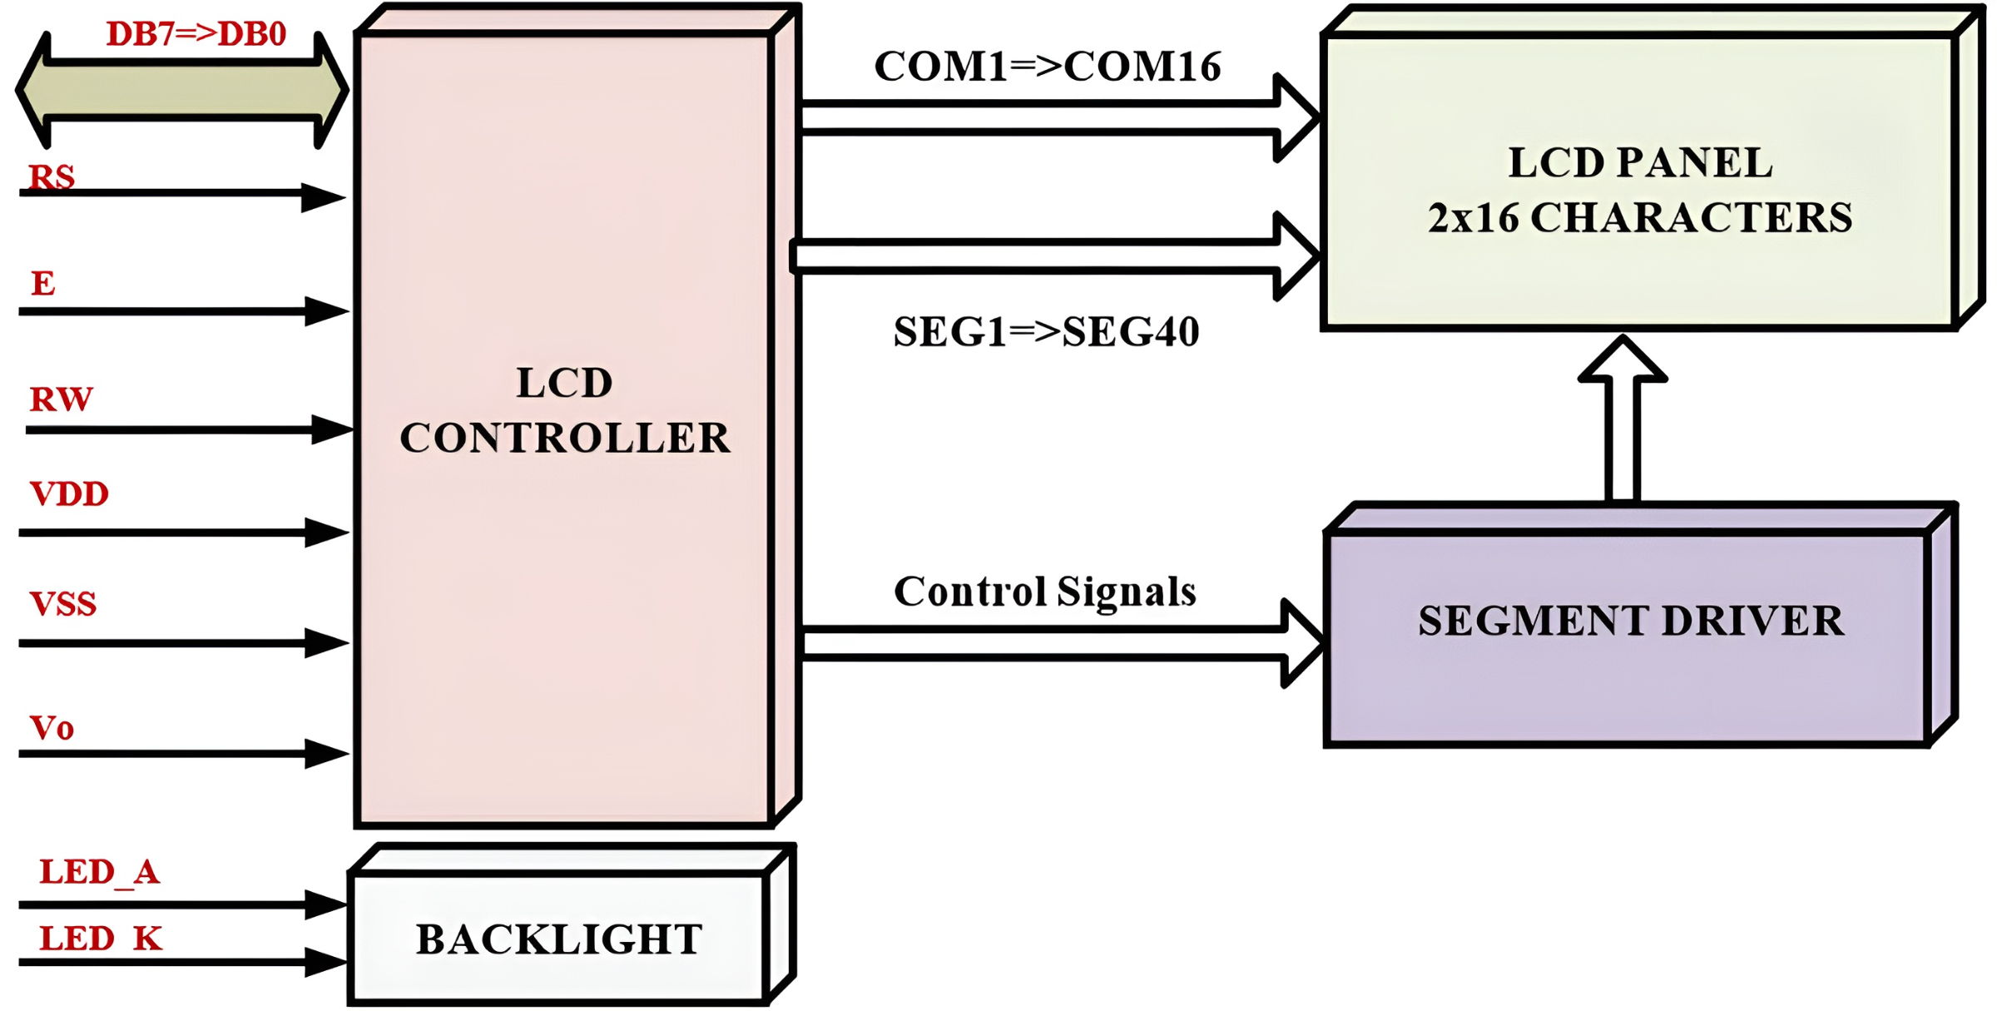
LAB 4: GPIO – LCD
1. CONTROL LCD IN 8 BIT MODE
LCD16X2 AND LCD20X4
STM32 EMBEDDED SYSTEMS
ARM CORTEX M

Slide 8
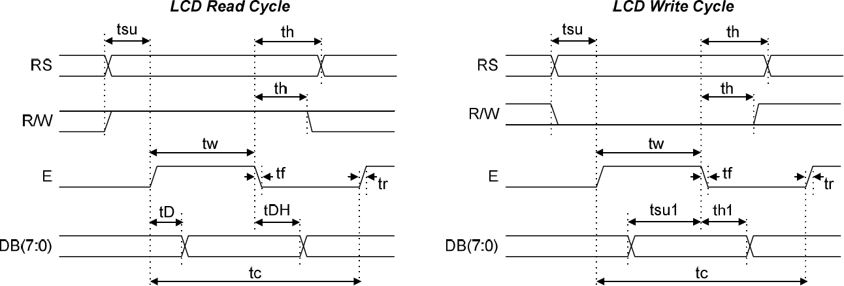
LAB 4: GPIO – LCD
1. CONTROL LCD IN 8 BIT MODE
LCD16X2 AND LCD20X4
STM32 EMBEDDED SYSTEMS
ARM CORTEX M

Slide 9
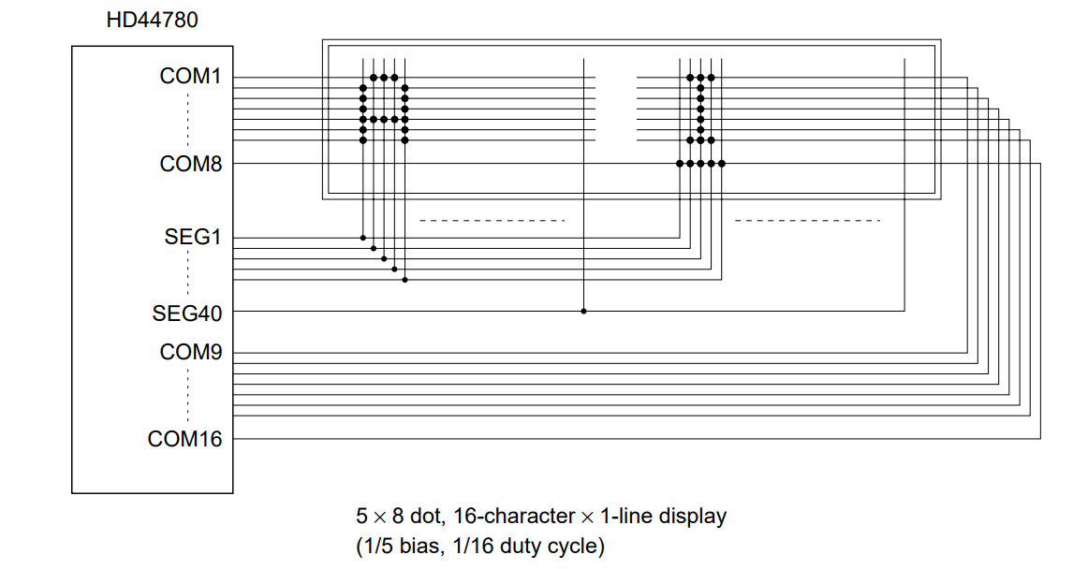
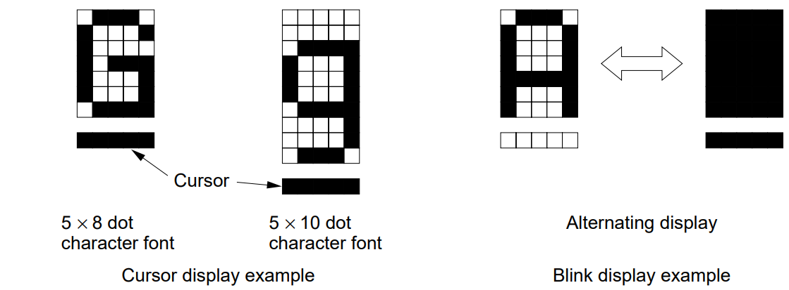
LAB 4: GPIO – LCD
1. CONTROL LCD IN 8 BIT MODE
LCD16X2 AND LCD20X4
STM32 EMBEDDED SYSTEMS
ARM CORTEX M

Slide 10
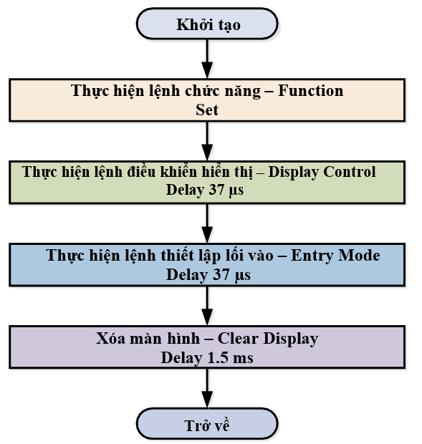
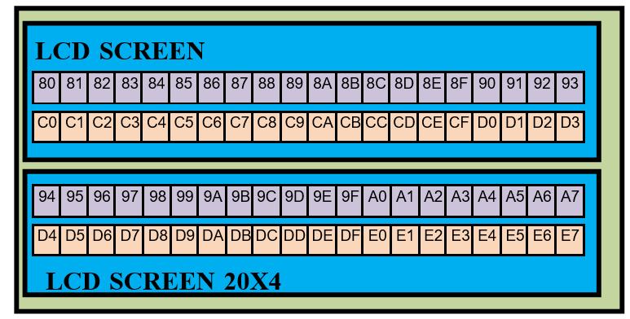
LAB 4: GPIO – LCD
1. CONTROL LCD IN 8 BIT MODE
LCD16X2 AND LCD20X4
STM32 EMBEDDED SYSTEMS
ARM CORTEX M

Slide 11
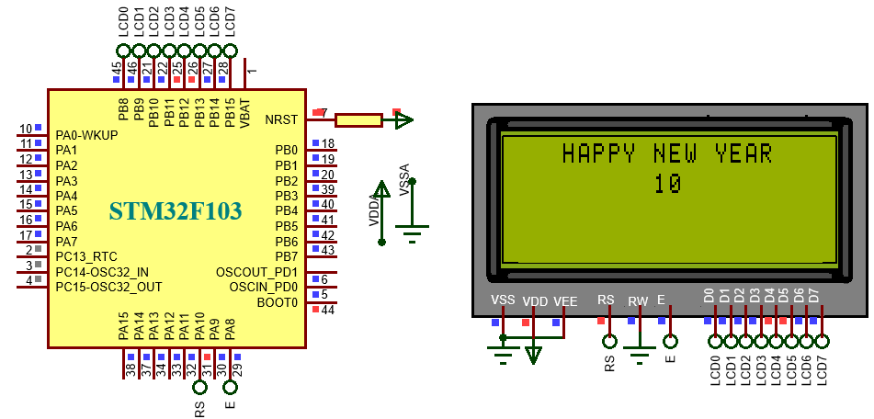
LAB 4: GPIO – LCD
1. CONTROL LCD IN 8 BIT MODE
P1. Write a program to control LCD 20x4 in 8 bit mode. Then display a string “HAPPY NEW YEAR” in line 0 and display the value of variable “count” from 00 – 99 in the middle of the LCD.
STM32 EMBEDDED SYSTEMS
ARM CORTEX M

Slide 12
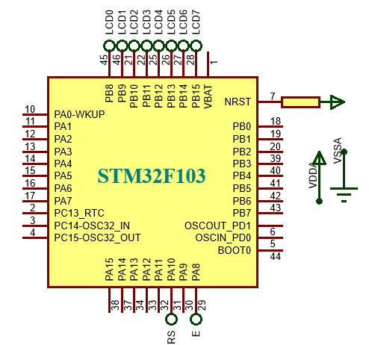
LAB 4: GPIO – LCD
void delay_us(uint32_t us)
{
for (uint32_t i = 0; i < us; ++i);
}
void output_8bit(char byte)
{
HAL_GPIO_WritePin(GPIOB,GPIO_PIN_15,(GPIO_PinState)(byte&128)); HAL_GPIO_WritePin(GPIOB,GPIO_PIN_14,(GPIO_PinState)(byte&64)); HAL_GPIO_WritePin(GPIOB,GPIO_PIN_13,(GPIO_PinState)(byte&32)); HAL_GPIO_WritePin(GPIOB,GPIO_PIN_12,(GPIO_PinState)(byte&16)); HAL_GPIO_WritePin(GPIOB,GPIO_PIN_11,(GPIO_PinState)(byte&8)); HAL_GPIO_WritePin(GPIOB,GPIO_PIN_10,(GPIO_PinState)(byte&4)); HAL_GPIO_WritePin(GPIOB,GPIO_PIN_9,(GPIO_PinState)(byte&2)); HAL_GPIO_WritePin(GPIOB,GPIO_PIN_8,(GPIO_PinState)(byte&1));
}
STM32 EMBEDDED SYSTEMS
ARM CORTEX M

Slide 13
LAB 4: GPIO – LCD
void lcd_command(char data) {
HAL_GPIO_WritePin(GPIOA, GPIO_PIN_10, GPIO_PIN_RESET); HAL_GPIO_WritePin(GPIOA, GPIO_PIN_8, GPIO_PIN_SET); output_8bit(data); delay_us(200);
HAL_GPIO_WritePin(GPIOA, GPIO_PIN_8, GPIO_PIN_RESET); delay_us(200);
}
void lcd_data(char data) {
HAL_GPIO_WritePin(GPIOA, GPIO_PIN_10, GPIO_PIN_SET); HAL_GPIO_WritePin(GPIOA, GPIO_PIN_8, GPIO_PIN_SET); output_8bit(data); delay_us(20);
HAL_GPIO_WritePin(GPIOA, GPIO_PIN_8, GPIO_PIN_RESET); delay_us(20);
}
STM32 EMBEDDED SYSTEMS
ARM CORTEX M

Slide 14
LAB 4: GPIO – LCD
void lcdstring_display(char* string)
{
while(*string)
{
lcd_data(*string);
string++;
}
}
void lcd_goto(uint8_t x, uint8_t y)
{
char lcd_pos[] ={0x80, 0xc0, 0x94, 0xd4};
lcd_command(lcd_pos[x] + y);
}
STM32 EMBEDDED SYSTEMS
ARM CORTEX M

Slide 15
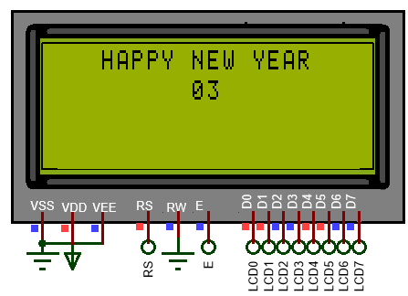
LAB 4: GPIO – LCD
void lcd_setup(void)
{
lcd_command(0x38);
HAL_Delay(1);
lcd_command(0x0c);
lcd_command(0x01);
HAL_Delay(2);
lcd_command(0x06);
}
lcd_setup(); lcd_goto(0,3); lcdstring_display("HAPPY NEW YEAR");
lcd_goto(1,9); lcd_data(count/10 + 0x30); lcd_data(count%10 + 0x30); count++; count%=21; HAL_Delay(500);
STM32 EMBEDDED SYSTEMS
ARM CORTEX M

Slide 16
LAB 4: GPIO – LCD
2. CONTROL LCD IN 4 BIT MODE
P2. Write a program to control LCD 20x4 in 4 bit mode. Then display a string “HAPPY NEW YEAR” in line 0 and display the value of variable “count” from 00 – 99 in the middle of the LCD.
STM32 EMBEDDED SYSTEMS
ARM CORTEX M

Slide 17
LAB 4: GPIO – LCD
P2. Write a program to control LCD 20x4 in 4 bit mode. Then display a string “HAPPY NEW YEAR” in line 0 and display the value of variable “count” from 00 – 99 in the middle of the LCD.
void delay_us(uint32_t us)
{
for (uint32_t i = 0; i < us; ++i);
}
void output_4bit(char byte)
{
HAL_GPIO_WritePin(GPIOB,GPIO_PIN_15,(GPIO_PinState)(byte&128)); HAL_GPIO_WritePin(GPIOB,GPIO_PIN_14,(GPIO_PinState)(byte&64)); HAL_GPIO_WritePin(GPIOB,GPIO_PIN_13,(GPIO_PinState)(byte&32)); HAL_GPIO_WritePin(GPIOB,GPIO_PIN_12,(GPIO_PinState)(byte&16));
}
STM32 EMBEDDED SYSTEMS
ARM CORTEX M

Slide 18
LAB 4: GPIO – LCD
void lcd_command(char data)
{
HAL_GPIO_WritePin(GPIOA,GPIO_PIN_10,GPIO_PIN_RESET); HAL_GPIO_WritePin(GPIOA,GPIO_PIN_8,GPIO_PIN_SET); HAL_Delay(1);
output_4bit(data); HAL_GPIO_WritePin(GPIOA,GPIO_PIN_8,GPIO_PIN_RESET);
HAL_GPIO_WritePin(GPIOA,GPIO_PIN_8,GPIO_PIN_SET); output_4bit(data<<4);
HAL_Delay(1); HAL_GPIO_WritePin(GPIOA,GPIO_PIN_8,GPIO_PIN_RESET);
}
STM32 EMBEDDED SYSTEMS
ARM CORTEX M

Slide 19
LAB 4: GPIO – LCD
void lcd_data(char data)
{
HAL_GPIO_WritePin(GPIOA,GPIO_PIN_10,GPIO_PIN_SET); HAL_GPIO_WritePin(GPIOA,GPIO_PIN_8,GPIO_PIN_SET); delay_us(500);
output_4bit(data); HAL_GPIO_WritePin(GPIOA,GPIO_PIN_8,GPIO_PIN_RESET);
HAL_GPIO_WritePin(GPIOA,GPIO_PIN_8,GPIO_PIN_SET); output_4bit(data<<4);
delay_us(500); HAL_GPIO_WritePin(GPIOA,GPIO_PIN_8,GPIO_PIN_RESET);
}
STM32 EMBEDDED SYSTEMS
ARM CORTEX M

Slide 20
LAB 4: GPIO – LCD
void lcd_goto(uint8_t x, uint8_t y)
{
char lcd_pos[] ={0x80, 0xc0, 0x94, 0xd4}; lcd_command(lcd_pos[x] + y);
}
void lcdstring_display(char* string)
{
while(*string)
{
lcd_data(*string);
string++;
}
}
STM32 EMBEDDED SYSTEMS
ARM CORTEX M

Slide 21
LAB 4: GPIO – LCD
void lcd_setup(void)
{
HAL_Delay(30);
HAL_GPIO_WritePin(GPIOB,GPIO_PIN_12,GPIO_PIN_RESET); HAL_GPIO_WritePin(GPIOB,GPIO_PIN_13,GPIO_PIN_SET); HAL_GPIO_WritePin(GPIOB,GPIO_PIN_14,GPIO_PIN_RESET); HAL_GPIO_WritePin(GPIOB,GPIO_PIN_15,GPIO_PIN_RESET); HAL_GPIO_WritePin(GPIOA,GPIO_PIN_8,GPIO_PIN_RESET); HAL_GPIO_WritePin(GPIOA,GPIO_PIN_8,GPIO_PIN_SET); HAL_GPIO_WritePin(GPIOA,GPIO_PIN_8,GPIO_PIN_RESET); lcd_command(0x28);
lcd_command(0x0c);
lcd_command(0x06);
lcd_command(0x01);
}
STM32 EMBEDDED SYSTEMS
ARM CORTEX M

Slide 22
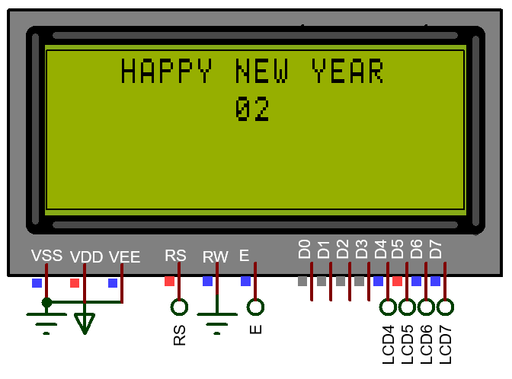
LAB 4: GPIO – LCD
lcd_setup();
lcd_goto(0,3);
lcdstring_display("HAPPY NEW YEAR");
while (1)
{
lcd_goto(1,9);
lcd_data(count/10 + 0x30);
lcd_data(count%10 + 0x30);
count++; count%=21;
HAL_Delay(500);
}
STM32 EMBEDDED SYSTEMS
ARM CORTEX M

Slide 23
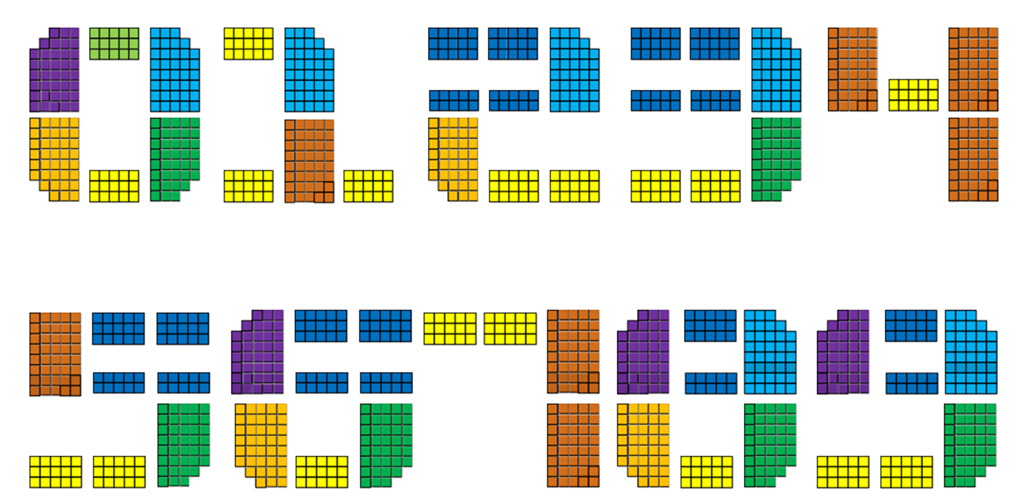
LAB 4: GPIO – LCD
4. CREATING CUSTOM CHARACTER
STM32 EMBEDDED SYSTEMS
ARM CORTEX M

Slide 24
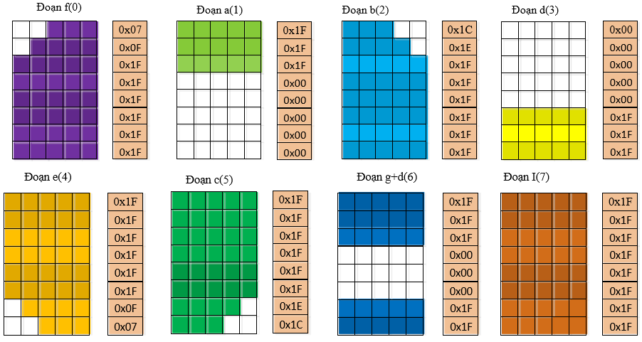
LAB 4: GPIO – LCD
4. CREATING CUSTOM CHARACTER
STM32 EMBEDDED SYSTEMS
ARM CORTEX M

Slide 25
LAB 4: GPIO – LCD
4. CREATING CUSTOM CHARACTER
STM32 EMBEDDED SYSTEMS
ARM CORTEX M

Slide 26
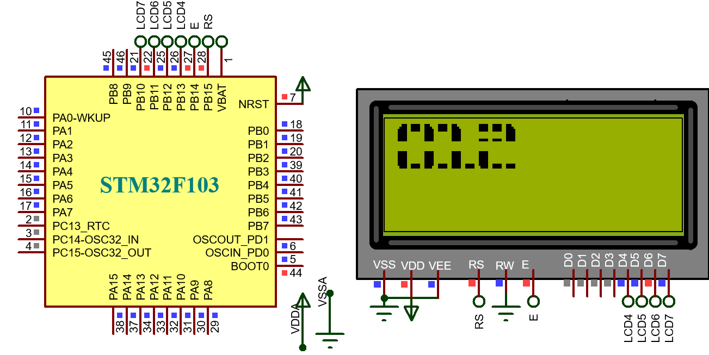
LAB 4: GPIO – LCD
4. CREATING CUSTOM CHARACTER
P3. Write a program to display “012” in lcd 20x4 with font 2x3 means two of rows and three of columns of lcd. It’s optional to choose the interface mode.
STM32 EMBEDDED SYSTEMS
ARM CORTEX M

Slide 27
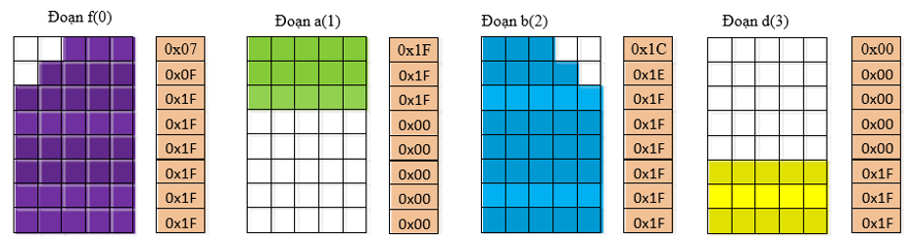
LAB 4: GPIO – LCD
const uint8_t lcd_ma_8doan[] = { 0x07,0x0f,0x1f,0x1f,0x1f,0x1f,0x1f,0x1f, //doan f - 0 0x1f,0x1f,0x1f,0x00,0x00,0x00,0x00,0x00, //doan a - 1 0x1c,0x1e,0x1f,0x1f,0x1f,0x1f,0x1f,0x1f, //doan b - 2 0x00,0x00,0x00,0x00,0x00,0x1f,0x1f,0x1f, //doan d - 3 0x1f,0x1f,0x1f,0x1f,0x1f,0x1f,0x0f,0x07, //doan e - 4 0x1f,0x1f,0x1f,0x1f,0x1f,0x1f,0x1e,0x1c, //doan c - 5 0x1f,0x1f,0x1f,0x00,0x00,0x00,0x1f,0x1f, //doan g+d-6 0x1f,0x1f,0x1f,0x1f,0x1f,0x1f,0x1f,0x1f}; //doan i -7
uint8_t i;
lcd_command(0x40); for(i=0;i<64;i++)
Lcd_data(lcd_ma_8doan[i]);
STM32 EMBEDDED SYSTEMS
ARM CORTEX M

Slide 28
LAB 4: GPIO – LCD
const uint8_t lcd_so_to[10][6] =
{
0,1,2,4,3,5, // so 0
1,2,32,3,7,3, // so 1
6,6,2,4,3,3, // so 2
6,6,2,3,3,5, // so 3
7,3,7,32,32,7,// so 4
7,6,6,3,3,5, // so 5
0,6,6,4,3,5, // so 6
1,1,7,32,32,7,// so 7
0,6,2,4,3,5, // so 8
0,6,2,3,3,5}; // so 9
STM32 EMBEDDED SYSTEMS
ARM CORTEX M

Slide 29
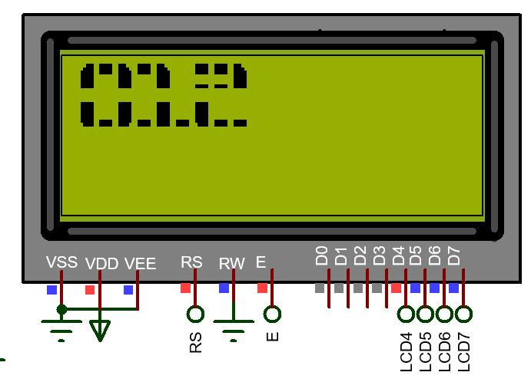
LAB 4: GPIO – LCD
void lcd2x3_display(uint8_t so, uint8_t x,uint8_t y) {
uint8_t i;
lcd_goto(x,y);
for(i=0;i<6;i++)
{
if(i==3) lcd_goto(x+1,y);
lcd_data(lcd_so_to[so][i]);
}
}
STM32 EMBEDDED SYSTEMS
ARM CORTEX M

Slide 30
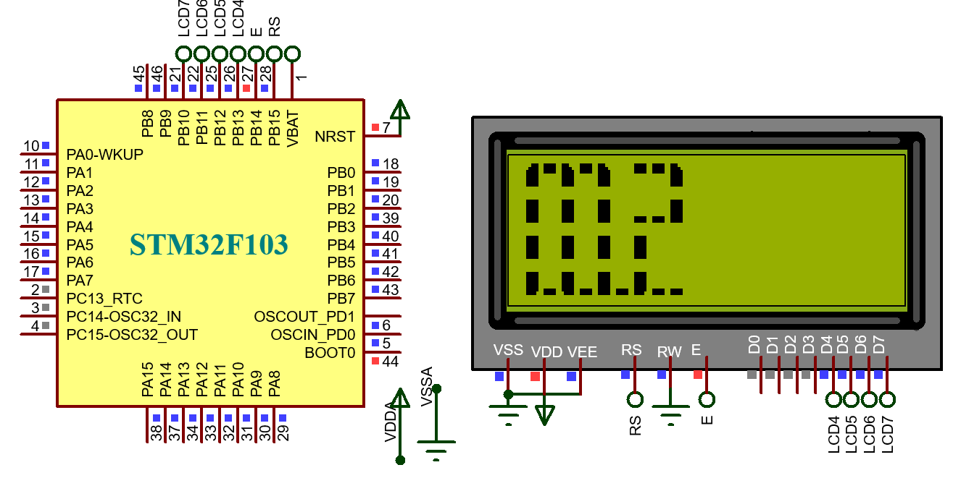
LAB 4: GPIO – LCD
4. CREATING CUSTOM CHARACTER
P4. Write a program to display “012” in lcd 20x4 with font 3x4 means three of columns and four of rows of lcd. It’s optional to choose the interface mode.
STM32 EMBEDDED SYSTEMS
ARM CORTEX M

Slide 31
LAB 4: GPIO – LCD
const uint8_t LCD_SO_X1[11][12] ={ //Font 3x4 0,1,2,7,32,7,7,32,7,5,3,4, //0 1,2,32,32,7,32,32,7,32,3,7,3, //1 1,1,2,3,3,7,7,32,32,5,3,3, //2 0,1,2,32,3,4,32,32,2,5,3,4, //3 7,32,7,5,3,7,32,32,7,32,32,7, //4 7,1,1,7,3,3,32,32,7,5,3,4, //5 0,1,2,7,3,3,7,32,7,5,3,4, //6 1,1,7,32,32,4,32,0,32,32,7,32, //7 0,1,2,5,3,4,0,32,2,5,3,4, //8 0,1,2,5,3,7,32,32,7,5,3,4, //9 32,32,32,32,32,32,32,32,32,32,32,32};//XOA
STM32 EMBEDDED SYSTEMS
ARM CORTEX M

Slide 32
LAB 4: GPIO – LCD
void lcd3x4_display(uint8_t so, uint8_t y)
{
uint8_t i;
lcd_goto(0,y);
for(i=0;i<12;i++)
{
if(i==3) lcd_goto(1,y);
else if(i==6) lcd_goto(2,y);
else if(i==9) lcd_goto(3,y);
lcd_data(LCD_SO_X1[so][i]);
}
}
STM32 EMBEDDED SYSTEMS
ARM CORTEX M

